Slide 1
Cornerstone City Church Peninsula Plus Community Hoo Are Ya
13th October 2024

Slide 2


Slide 3
Hosanna (Praise Is Rising)
CCLI Song # 4662491
Brenton Brown | Paul Baloche
© 2005, 2006 Integrity's Hosanna! Music (Admin. by Integrity Music Ltd)
Thankyou Music (Admin. by Integrity Music Ltd)
For use solely with the SongSelect® Terms of Use. All rights reserved. www.ccli.com
CCLI Licence No. 33265

Slide 4
1/6
Praise is rising
Eyes are turning to You
We turn to You
Hope is stirring
Hearts are yearning for You
We long for You

Slide 5
2/6
‘Cause when we see You
We find strength to face the day
In Your presence
All our fears are washed away
(Washed away)

Slide 6
3/6
Hosanna Hosanna
You are the God who saves us
Worthy of all our praises
Hosanna Hosanna
Come have Your way among us
We welcome You here Lord Jesus

Slide 7
4/6
Hear the sound of
Hearts returning to You
We turn to You
In Your Kingdom
Broken lives are made new
You make us new

Slide 8
5/6
‘Cause when we see You
We find strength to face the day
In Your presence
All our fears are washed away
(Washed away)

Slide 9
6/6
Hosanna Hosanna
You are the God who saves us
Worthy of all our praises
Hosanna Hosanna
Come have Your way among us
We welcome You here Lord Jesus

Slide 10
Holy CCLI Song # 3233773
Brenton Brown
© 2001 Vineyard Songs (UK/Eire)
For use solely with the SongSelect® Terms of Use. All rights reserved. www.ccli.com
CCLI Licence No. 33265

Slide 11
1/3
Verse
Holy holy God Almighty
Who was and is to come
God of glory You're so worthy
All the saints bow down

Slide 12
2/3
Chorus
Holy is Your name in all the earth
Righteous are Your ways so merciful
Everything You've done is just and true
Holy holy God are You
Holy holy God (are You)

Slide 13
3/3
Bridge All blessing all honor belongs to You
All power all wisdom is Yours all blessing
All blessing all honor belongs to You
All power all wisdom is Yours

Slide 14
Great Are You Lord
CCLI Song # 6460220
David Leonard | Jason Ingram | Leslie Jordan
© 2012 Open Hands Music (Admin. by Essential Music Publishing LLC)
So Essential Tunes (Admin. by Essential Music Publishing LLC)
Integrity's Praise! Music (Admin. by Integrity Music Ltd)
Little Way Creative (Admin. by Integrity Music Ltd)
For use solely with the SongSelect® Terms of Use. All rights reserved. www.ccli.com
CCLI Licence No. 33265

Slide 15
1/3
You give life You are love
You bring light to the darkness
You give hope You restore ev'ry heart that is broken
And great are You Lord

Slide 16
2/3
It's Your breath in our lungs
So we pour out our praise
We pour out our praise
It's Your breath in our lungs
So we pour out our praise to You only

Slide 17
3/3
And all the earth will shout Your praise
Our hearts will cry these bones will sing
Great are You Lord
(REPEAT)

Slide 19
Cornerstone
CCLI Song # 6158927
Edward Mote | Eric Liljero | Jonas Myrin | Reuben Morgan | William Batchelder Bradbury
© 2011 Hillsong MP Songs (Admin. by Hillsong Music Publishing UK)
Hillsong Music Publishing Australia (Admin. by Hillsong Music Publishing UK)
Hillsong Music Publishing UK
For use solely with the SongSelect® Terms of Use. All rights reserved. www.ccli.com
CCLI Licence No. 33265

Slide 20
1/6
My hope is built on nothing less
Than Jesus' blood and righteousness
I dare not trust the sweetest frame
But wholly trust in Jesus' Name

Slide 21
2/6
Christ alone cornerstone
Weak made strong in the Saviour's love
Through the storm He is Lord
Lord of all

Slide 22
3/6
When darkness seems to hide His face
I rest on His unchanging grace
In every high and stormy gale
My anchor holds within the veil
My anchor holds within the veil

Slide 23
4/6
Christ alone cornerstone
Weak made strong in the Saviour's love
Through the storm He is Lord
Lord of all

Slide 24
5/6
When He shall come with trumpet sound
Oh may I then in Him be found
Dressed in His righteousness alone
Faultless stand before the throne

Slide 25
6/6
Christ alone cornerstone
Weak made strong in the Saviour's love
Through the storm He is Lord
Lord of all

Slide 26
Waiting Here For You
CCLI Song # 5925663
Chris Tomlin | Jesse Reeves | Martin Smith
© 2011 Rising Springs Music (Admin. by Capitol CMG Publishing)
Vamos Publishing (Admin. by Capitol CMG Publishing)
worshiptogether.com songs (Admin. by Capitol CMG Publishing)
Smith United (Admin. by Integrity Music Ltd)
Thankyou Music (Admin. by Integrity Music Ltd)
For use solely with the SongSelect® Terms of Use. All rights reserved. www.ccli.com
CCLI Licence No. 33265

Slide 27
1/7
If faith can move the mountains
Let the mountains move
We come with expectation
Waiting here for You
Waiting here for You

Slide 28
2/7
You're the Lord of all creation
And still You know my heart
The Author of salvation
You've loved us from the start

Slide 29
3/7
Waiting here for You with our hands
Lifted high in praise
And it's You we adore
Singing alleluia

Slide 30
4/7
You are ev'rything You've promised
Your faithfulness is true
We're desp'rate for Your presence
All we need is You

Slide 31
5/7
We will wait for You Lord
In step with You Lord we sing alleluia

Slide 32
6/7
Singing alleluia alleluia
Singing alleluia alleluia

Slide 33
7/7
Waiting here for You with our hands
Lifted high in praise
And it's You we adore singing alleluia
(We’re) singing alleluia

Slide 35


Slide 36
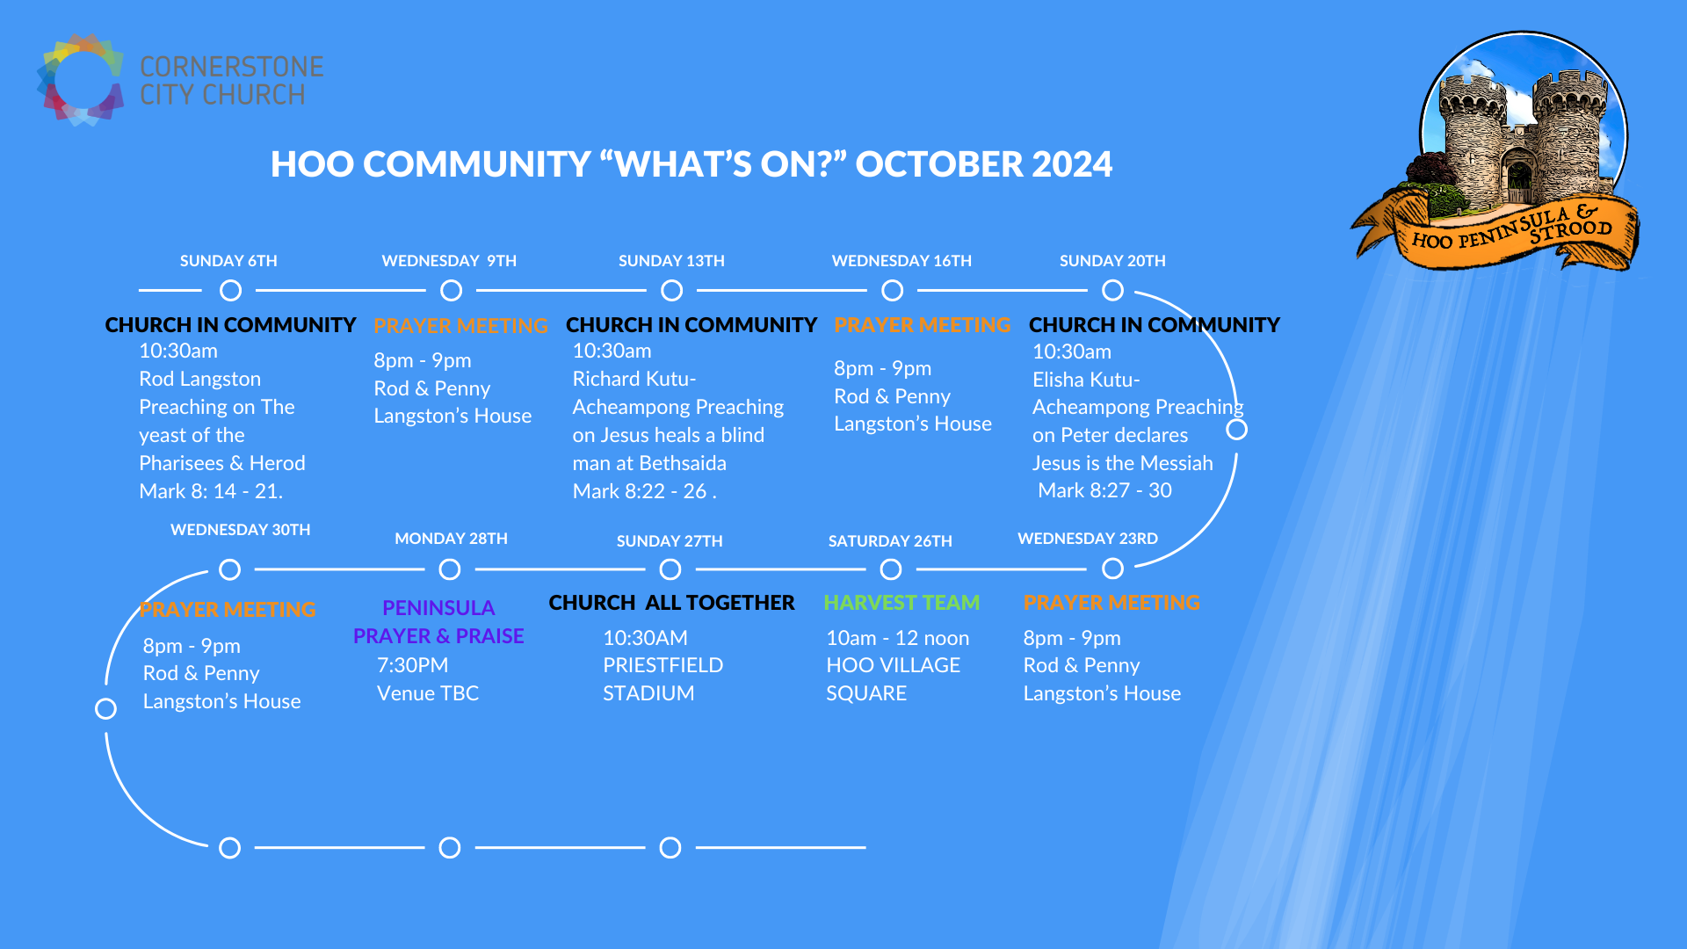

Slide 37


Slide 38
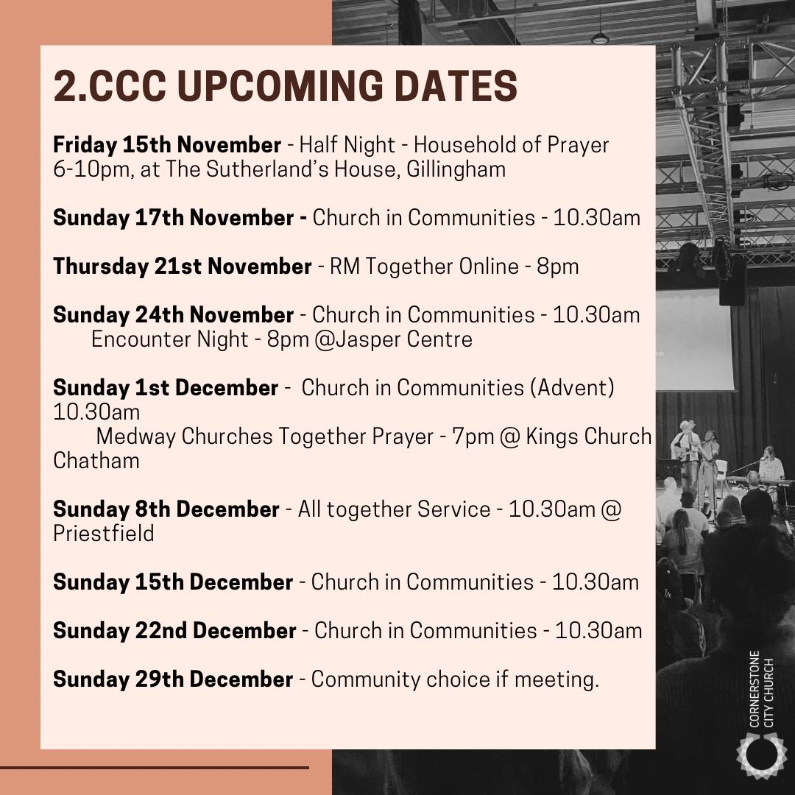

Slide 39


Slide 40
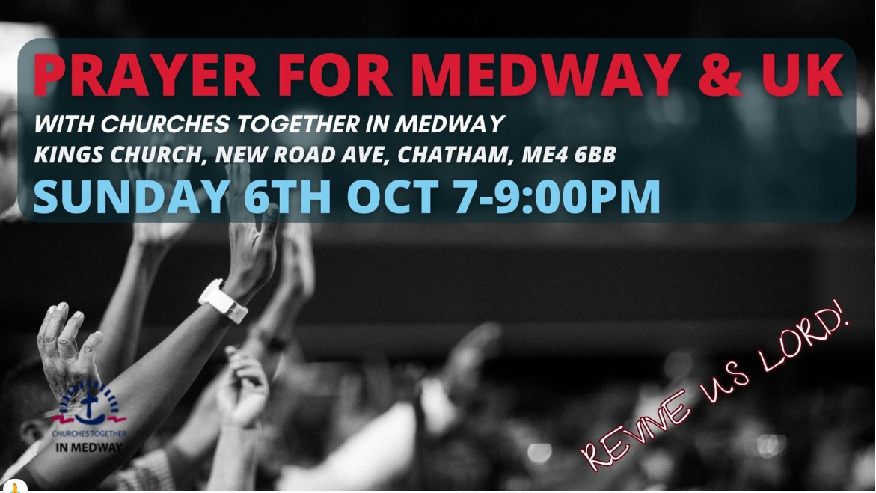

Slide 41
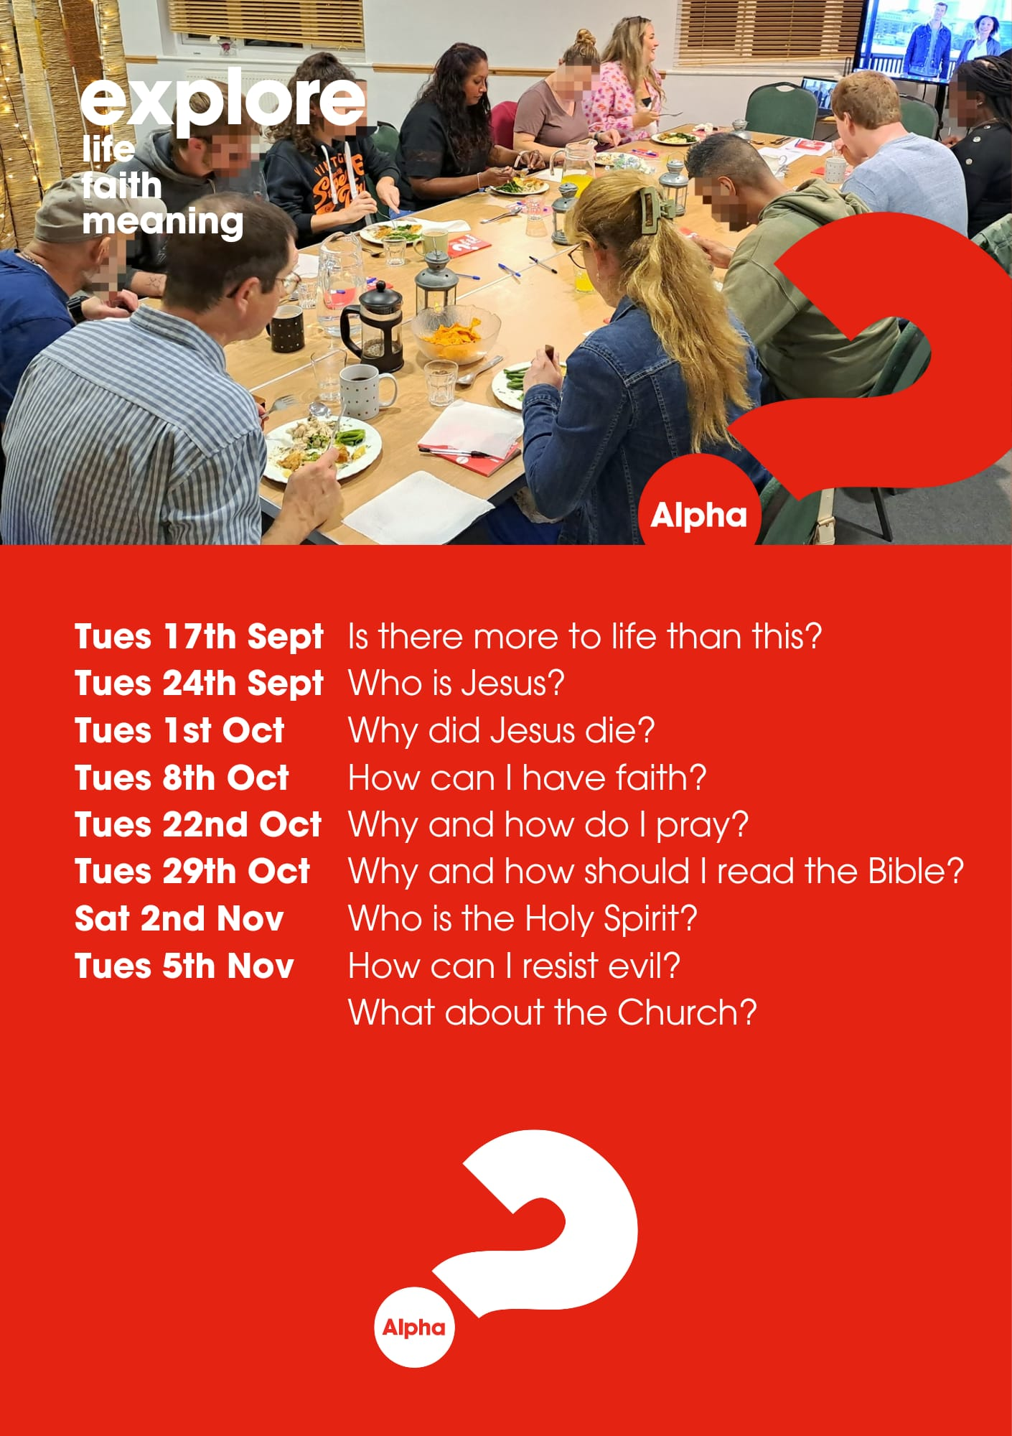

Slide 42
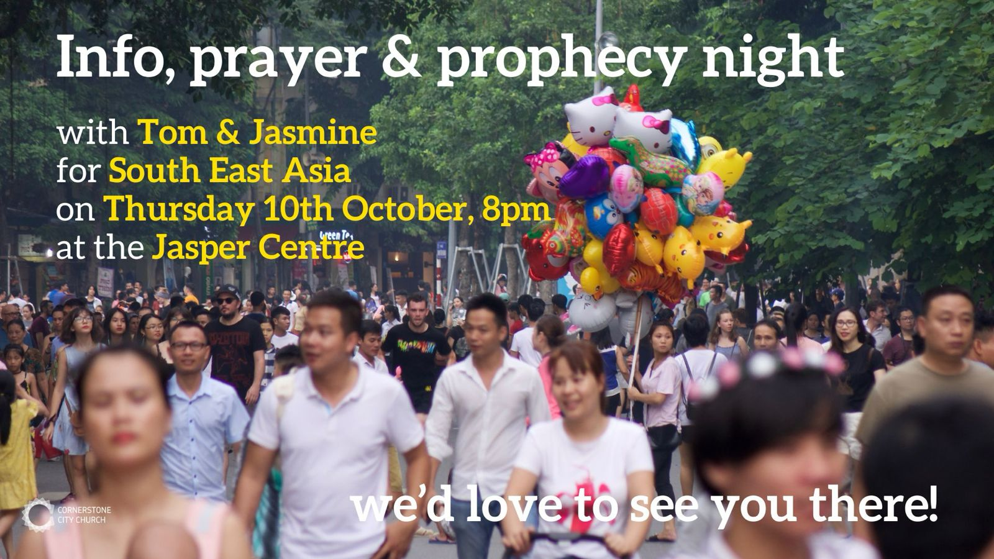

Slide 43


Slide 44
2 Corinthians 14 May the grace of the Lord Jesus Christ, and the love of God, and the fellowship of the Holy Spirit be with you all

